Slide 1
Cambio2.0
Diagnostic functions
Diagnostic variables
Propagate
ClimateState
Parametric variables
ClimateParams
Prognostic variables
ClimateState
Collect Climate
TimeSeries
Time series (numpy arrays)

Slide 2
Today
Recap of how dictionaries work
CreateClimateState: a function for creating a preindustrial climate state
Tailoring a climate state
Making a list of climate states
Extracting data from that list
Using PropagateClimateState to model Earth’s climate over time

Slide 3
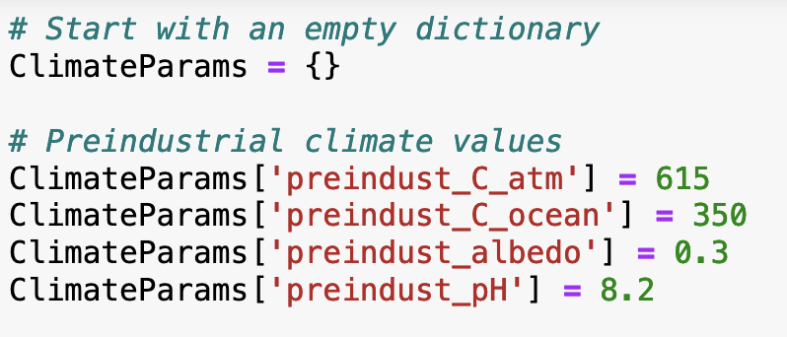
Recap of how dictionaries work
Creating a dictionary

Slide 4
Recap of how dictionaries work
Creating a dictionary
Adding values to a dictionary

Slide 5
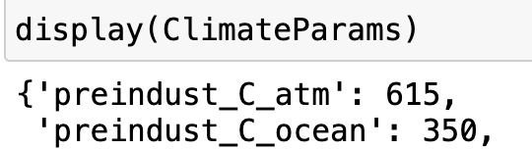
Recap of how dictionaries work
Creating a dictionary
Adding values to a dictionary
Displaying contents of dictionaries

Slide 6
Today
Recap of how dictionaries work
CreateClimateState: a function for creating a preindustrial climate state
Tailoring a climate state
Making a list of climate states
Extracting data from that list
Using PropagateClimateState to model Earth’s climate over time

Slide 7
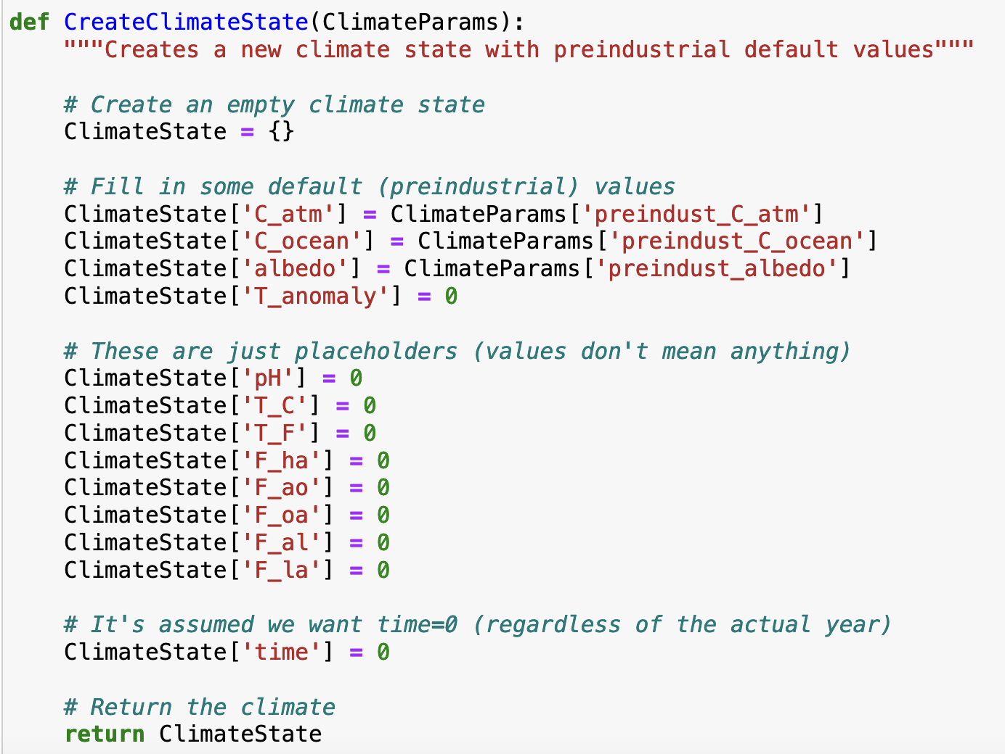
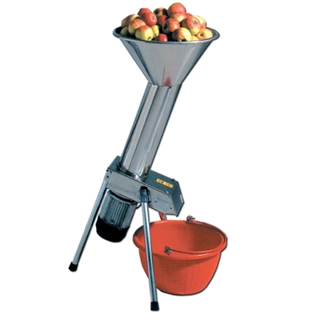
CreateClimateState: a function for creating a preindustrial climate state

Slide 8
CreateClimateState: a function for creating a preindustrial climate state

Slide 9
CreateClimateState: a function for creating a preindustrial climate state

Slide 10
CreateClimateState: a function for creating a preindustrial climate state

Slide 11
CreateClimateState: a function for creating a preindustrial climate state
$$κ_{T}$$

Slide 12
Today
Recap of how dictionaries work
CreateClimateState: a function for creating a preindustrial climate state
Tailoring a climate state
Making a list of climate states
Extracting data from that list
Using PropagateClimateState to model Earth’s climate over time

Slide 13
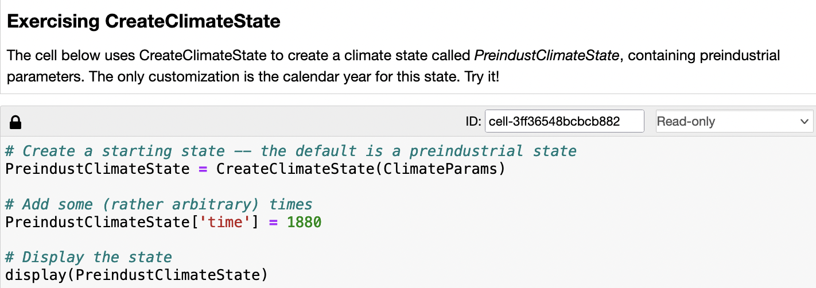
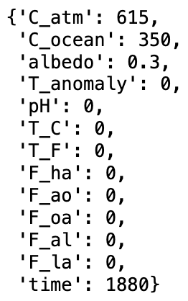
Tailoring a climate state

Slide 14
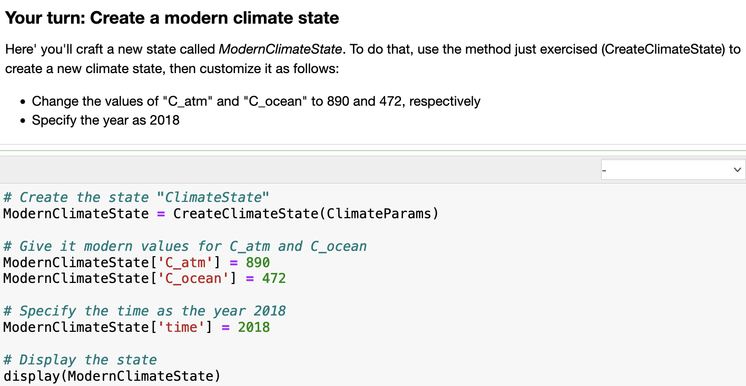
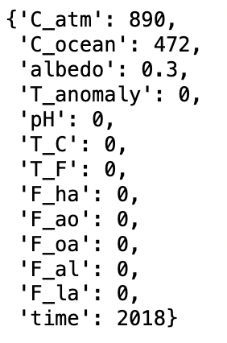
Tailoring a climate state

Slide 15
Today
Recap of how dictionaries work
CreateClimateState: a function for creating a preindustrial climate state
Tailoring a climate state
Making a list of climate states
Extracting data from that list
Using PropagateClimateState to model Earth’s climate over time

Slide 16
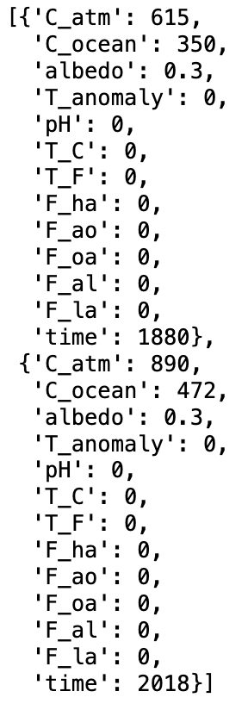
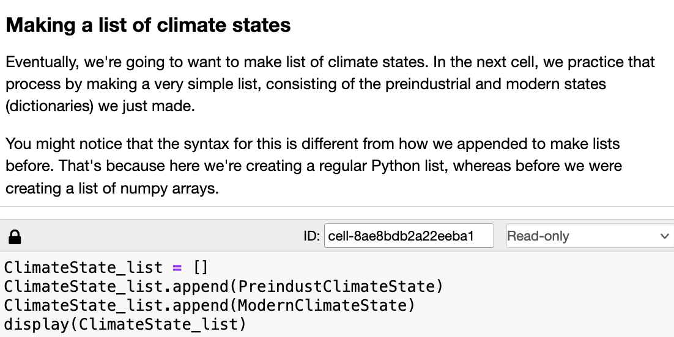
Making a list of climate states

Slide 17
Today
Recap of how dictionaries work
CreateClimateState: a function for creating a preindustrial climate state
Tailoring a climate state
Making a list of climate states
Extracting data from that list
Using PropagateClimateState to model Earth’s climate over time

Slide 18
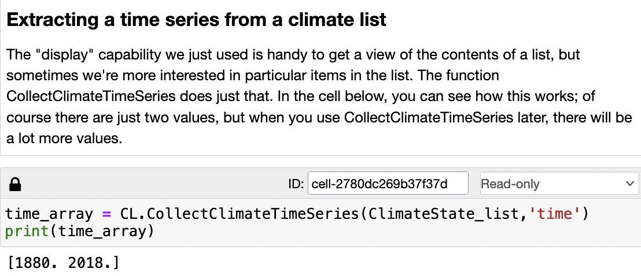
Extracting data from a list of climate states

Slide 19
Extracting data from a list of climate states
Q: How would you extract C_atm values from the list?

Slide 20
Extracting data from a list of climate states
Q: How would you extract C_atm values from the list?
A: Tell CollectClimateTimeSeries that you want ‘C_atm’

Slide 21

Extracting data from a list of climate states
Q: How would you extract C_atm values from the list?
A: Tell CollectClimateTimeSeries that you want ‘C_atm’

Slide 22
Today
Recap of how dictionaries work
CreateClimateState: a function for creating a preindustrial climate state
Tailoring a climate state
Making a list of climate states
Extracting data from that list
Using PropagateClimateState to model Earth’s climate over time

Slide 23
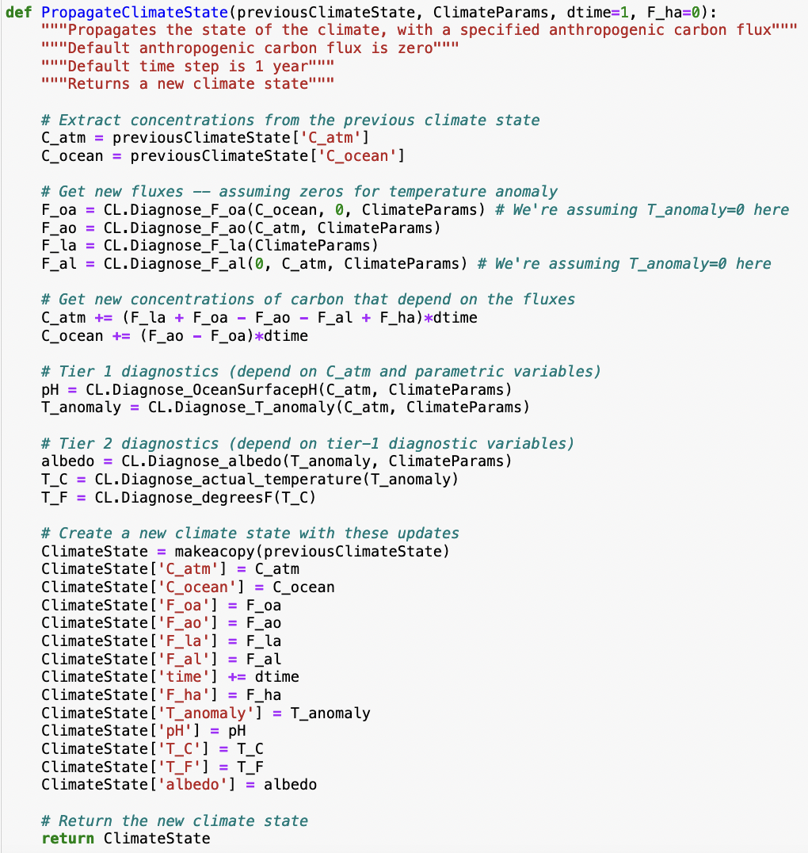
Using PropagateClimateState to model Earth’s climate over time
…

Slide 24
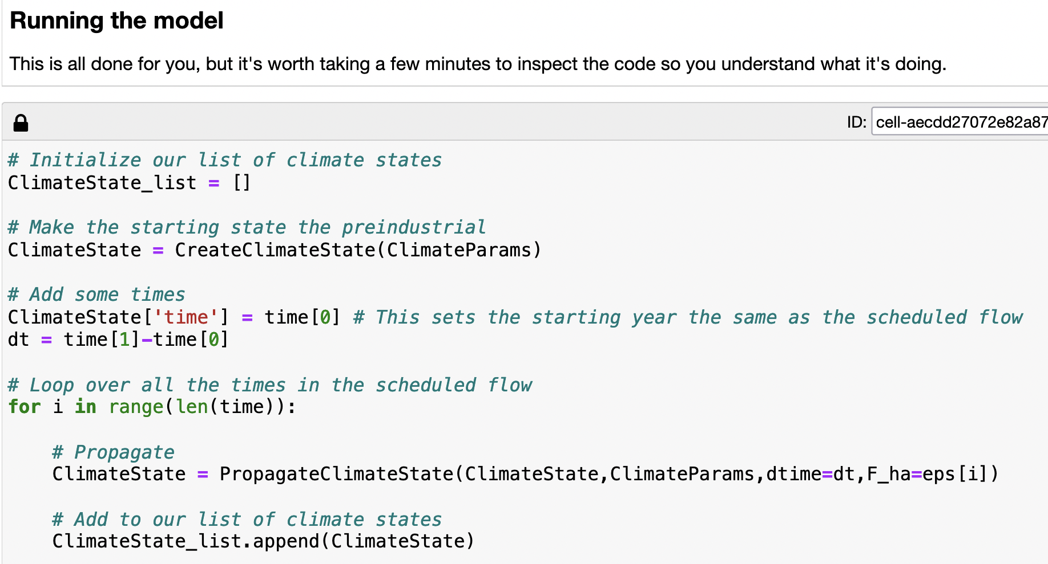
Using PropagateClimateState to model Earth’s climate over time

